Slide 1
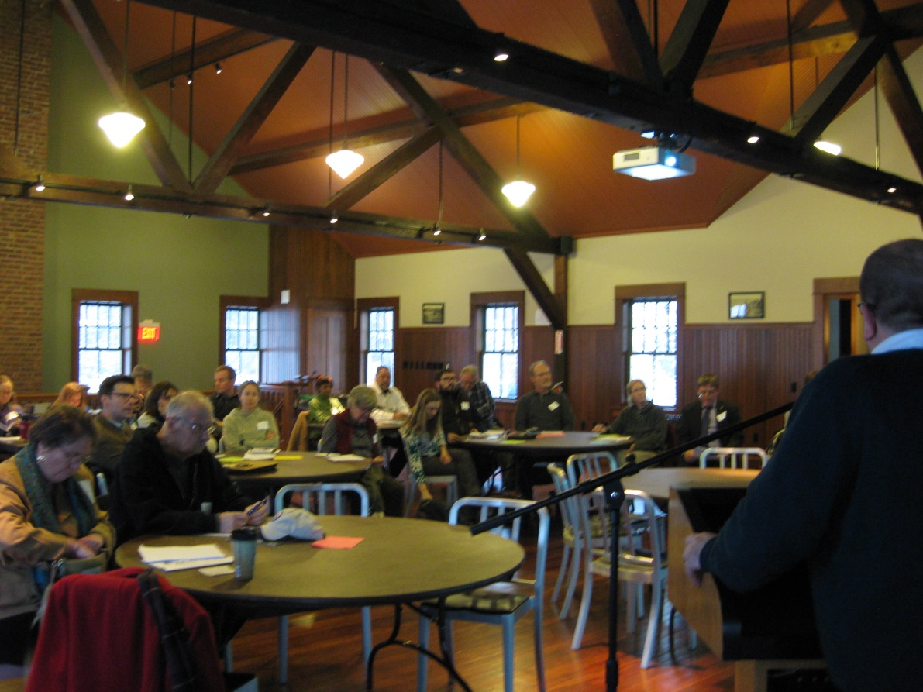
Hudson River Comprehensive Restoration Plan
Community Workshop
Spring 2015

Slide 2
Welcome
Purpose and Desired Outcomes
Gather specific information and ideas on how the Hudson River Comprehensive Restoration Plan can reflect riverfront community needs and opportunities for:
        Habitat restoration
        Waterfront infrastructure
        Recreation & access

Slide 3

Overview of the Restoration Plan
Partnerships
Partners Restoring the Hudson
Science
Ecological Assessment
Communities
Community Workshops
Quantifiable Goals and Objectives
Agencies
Federal
State
Community
Mitigation
Natural Resource Damage
Future Infrastructure
Private
Corporate
Foundations
Planning
Investment
IMPLEMENTATION

Slide 4
Restoration Plan: Planning Phase
Partnerships
Partners Restoring the Hudson
Science
Ecological Assessment
Community
Community Workshops
Quantifiable Goals and Objectives

Slide 5
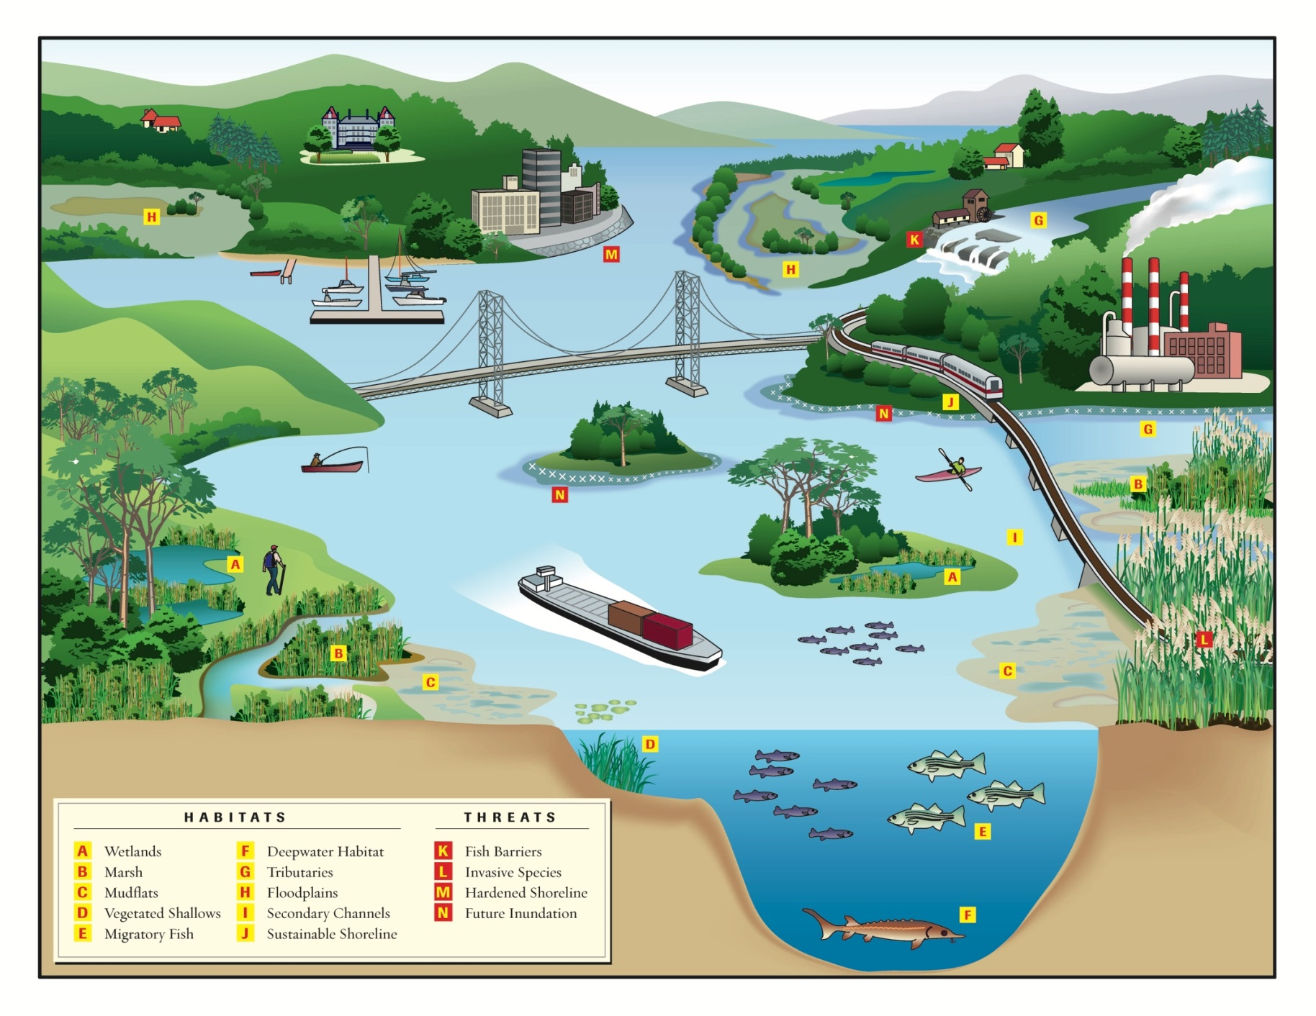
Whole Estuary Restoration

Slide 6
Target Ecosystem Characteristics
1. Tidal/Intertidal Wetlands
2. SAV/Shallow Water
3. Riparian Buffers and Floodplains
4. Tributary Connectivity and Barriers
5. Waste/Storm Water
6. Contaminants (Brownfields)
7. Sediment Quantity and Quality
8. Water Access and Navigability
9. Estuary Education Centers and Opportunities
10. Resilient Waterfronts and Shorelines
11. Commercial and Recreational Fisheries
12. Native Species and Communities

Slide 7
Target Ecosystem Characteristics

Slide 8
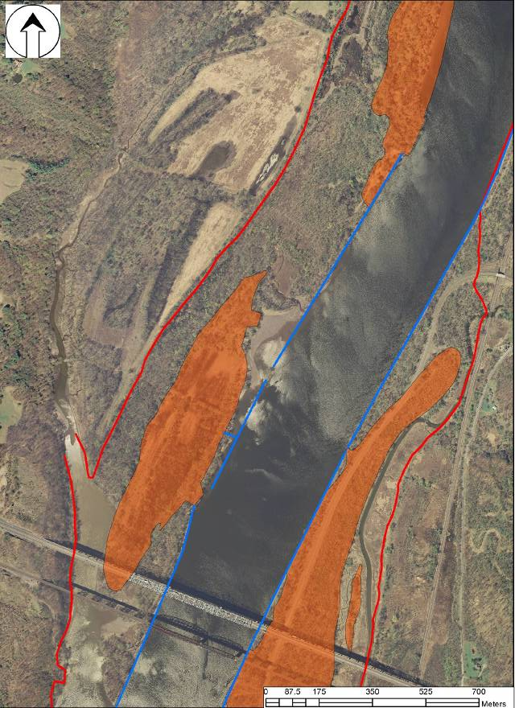
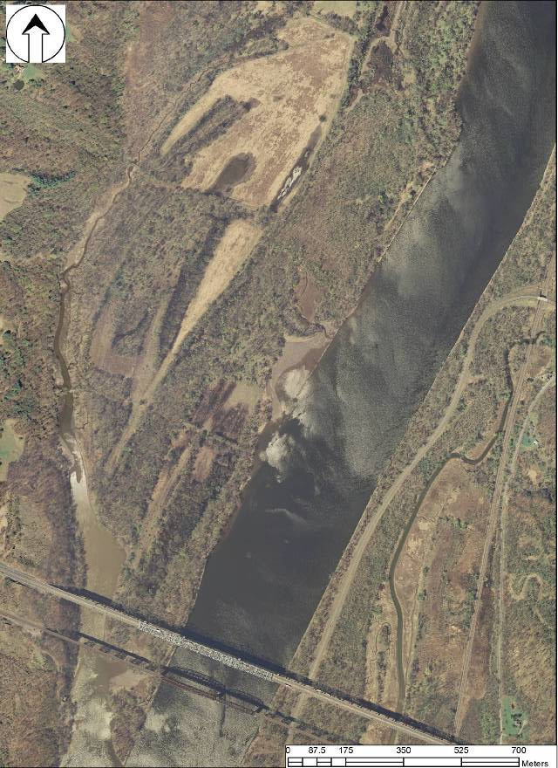
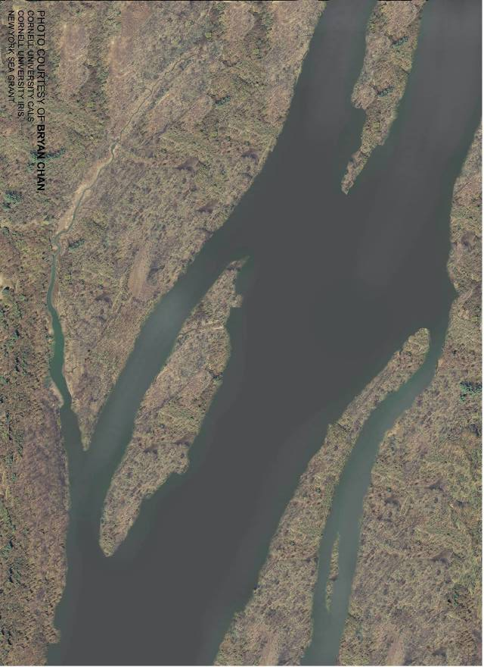
150 Years of Habitat Loss
Modern day air photo near Castleton, NY
Pre-navigation channel construction to present day

Slide 9
Target Ecosystem Characteristics

Slide 10
Community Opportunities & Needs
Target Ecosystem Characteristics
1. Tidal/Intertidal Wetlands
2. SAV/Shallow Water
3. Riparian Buffers and Floodplains
4. Tributary Connectivity and Barriers
5. Waste/Storm Water
6. Contaminants (Brownfields)
7. Sediment Quantity and Quality
8. Water Access and Navigability
9. Estuary Education Centers and Opportunities
10. Resilient Waterfronts and Shorelines
11. Commercial and Recreational Fisheries
12. Native Species and Communities
Habitat Restoration and Protection
Community Infrastructure
Recreation and Access

Slide 11
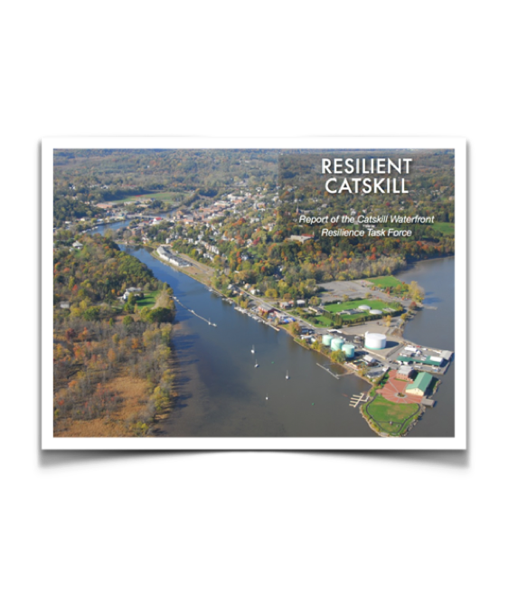
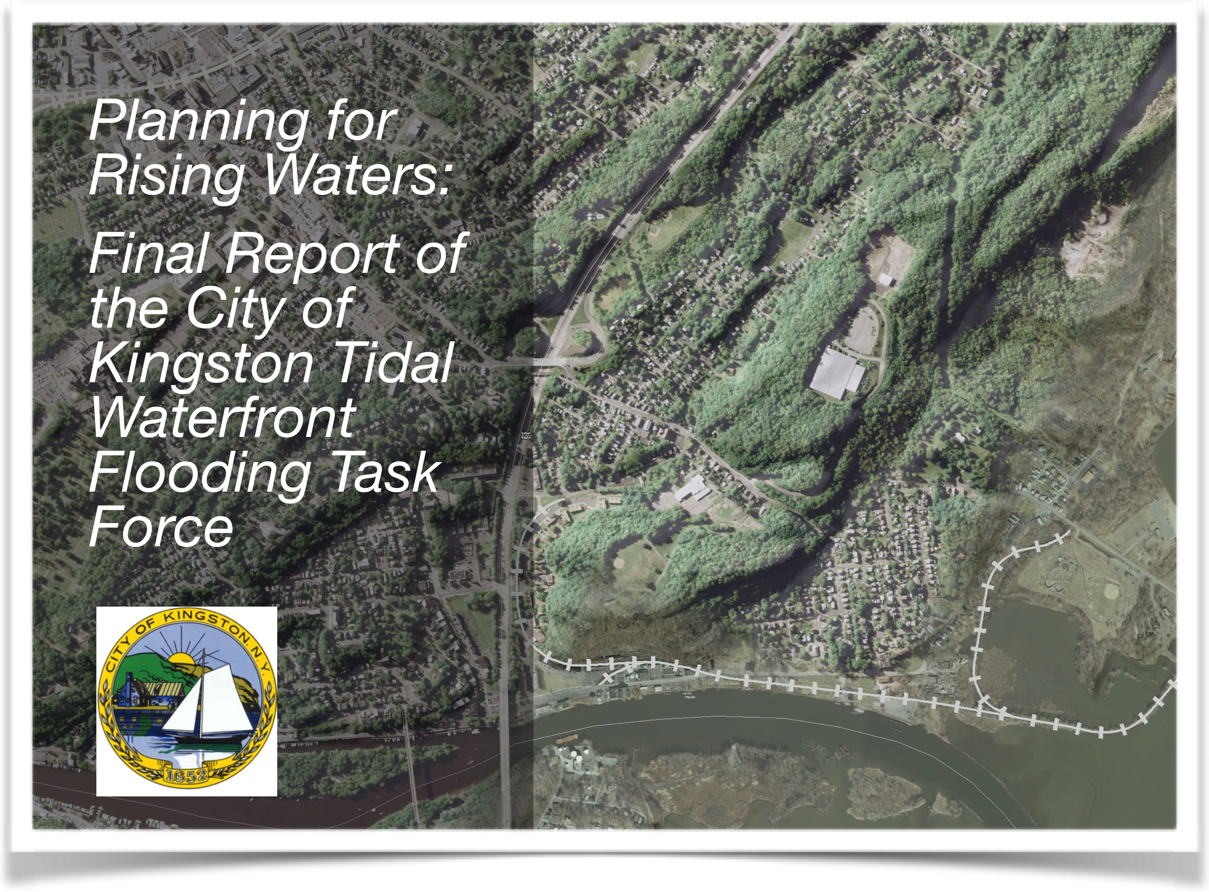
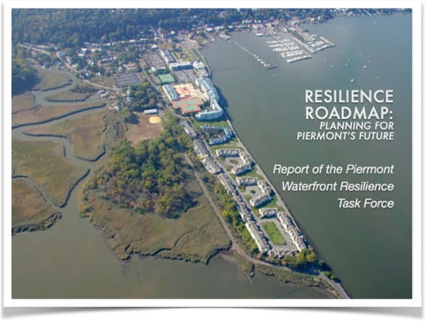
Planning for Resilience
Identify and prioritize strategies for making communities more resilient,
makes people & property safer
ensures waterfront vitality
conserves coastal natural resources

Slide 12
Habitat Restoration and Protection
  Shoreline stabilization
  Open/Green space protection
  Brownfields clean-up
  Control of Invasive species occurrences
  Protection of locally important natural resources

Slide 13
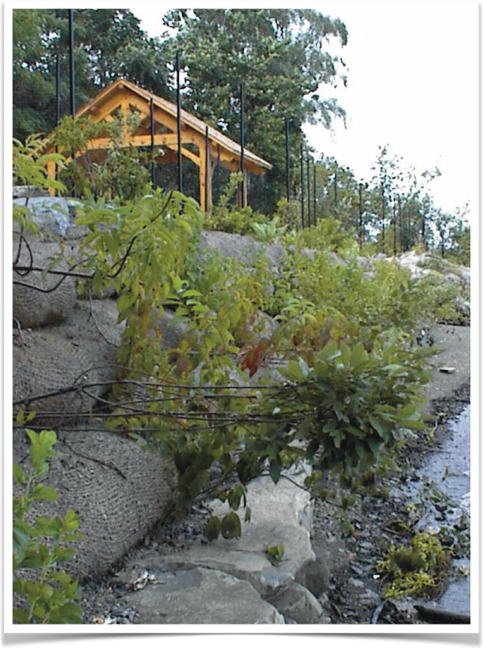
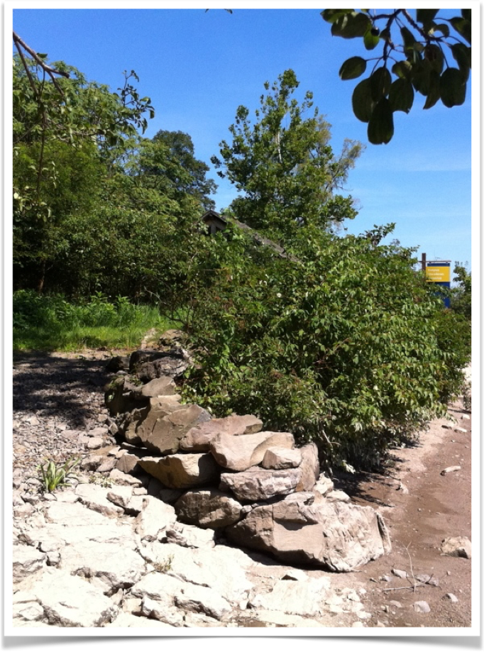
Habitat Restoration and Protection
  Shoreline stabilization
  Open/Green space protection
  Brownfields clean-up
  Control of Invasive species occurrences
  Protection of locally important natural resources

Slide 14
Habitat Restoration and Protection
  Shoreline stabilization
  Open/Green space protection
  Brownfields clean-up
  Control of Invasive species occurrences
  Protection of locally important natural resources

Slide 15
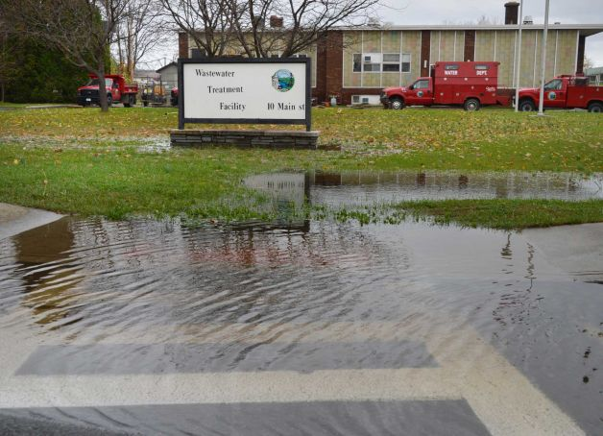
Community Infrastructure
  Contamination from combined sewer outfalls
  Vulnerable or inadequate wastewater treatment plants and pump stations
  Areas or structures prone or vulnerable to storm damage and flooding
  Problematic bridges, culverts and dams
  Green infrastructure (existing or planned/desired)
  Riverfront (re)development areas
  Brownfields clean-up
Community Infrastructure
Notes:
SACHA

Slide 16
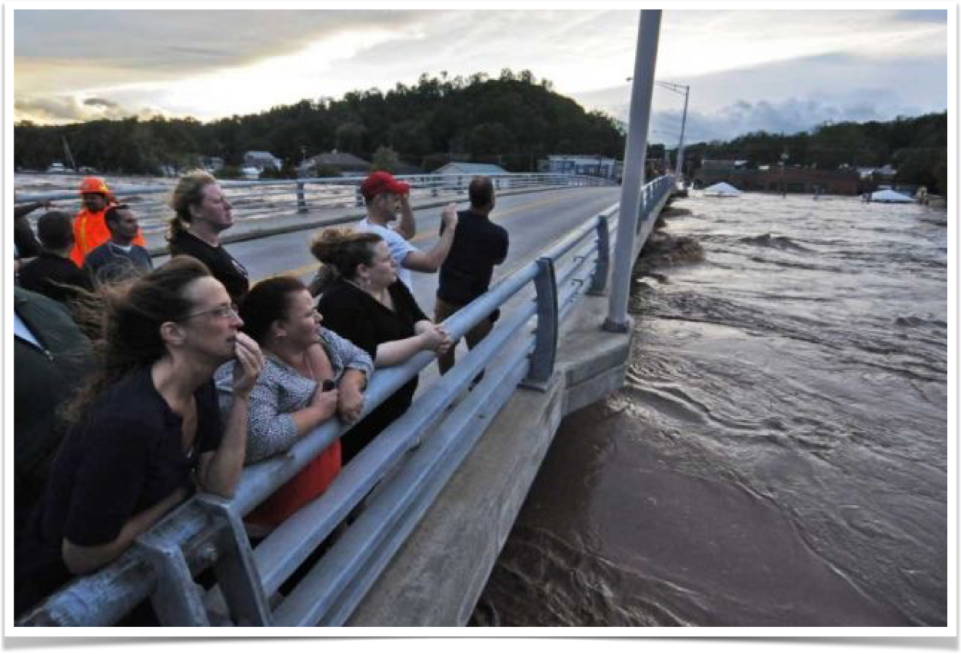
Community Infrastructure
  Contamination from combined sewer outfalls
  Vulnerable or inadequate wastewater treatment plants and pump stations
  Areas or structures prone or vulnerable to storm damage and flooding
  Problematic bridges, culverts and dams
  Green infrastructure (existing or planned/desired)
  Riverfront (re)development areas
  Brownfields clean-up
Community Infrastructure

Slide 17
Community Infrastructure
  Contamination from combined sewer outfalls
  Vulnerable or inadequate wastewater treatment plants and pump stations
  Areas or structures prone or vulnerable to storm damage and flooding
  Problematic bridges, culverts and dams
  Green infrastructure (existing or planned/desired)
  Riverfront (re)development areas
  Brownfields clean-up
Community Infrastructure

Slide 18
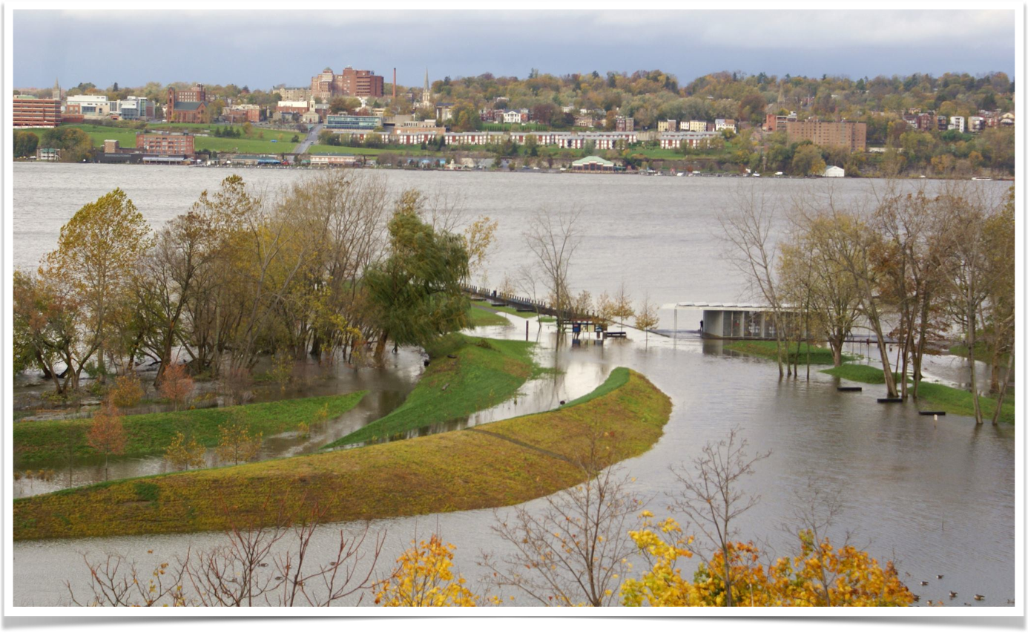
Recreation and Access
  Undeveloped fishing, swimming or boat launch areas
  Access areas in need of repair
  Vulnerable historic or natural features
  Other

Slide 19
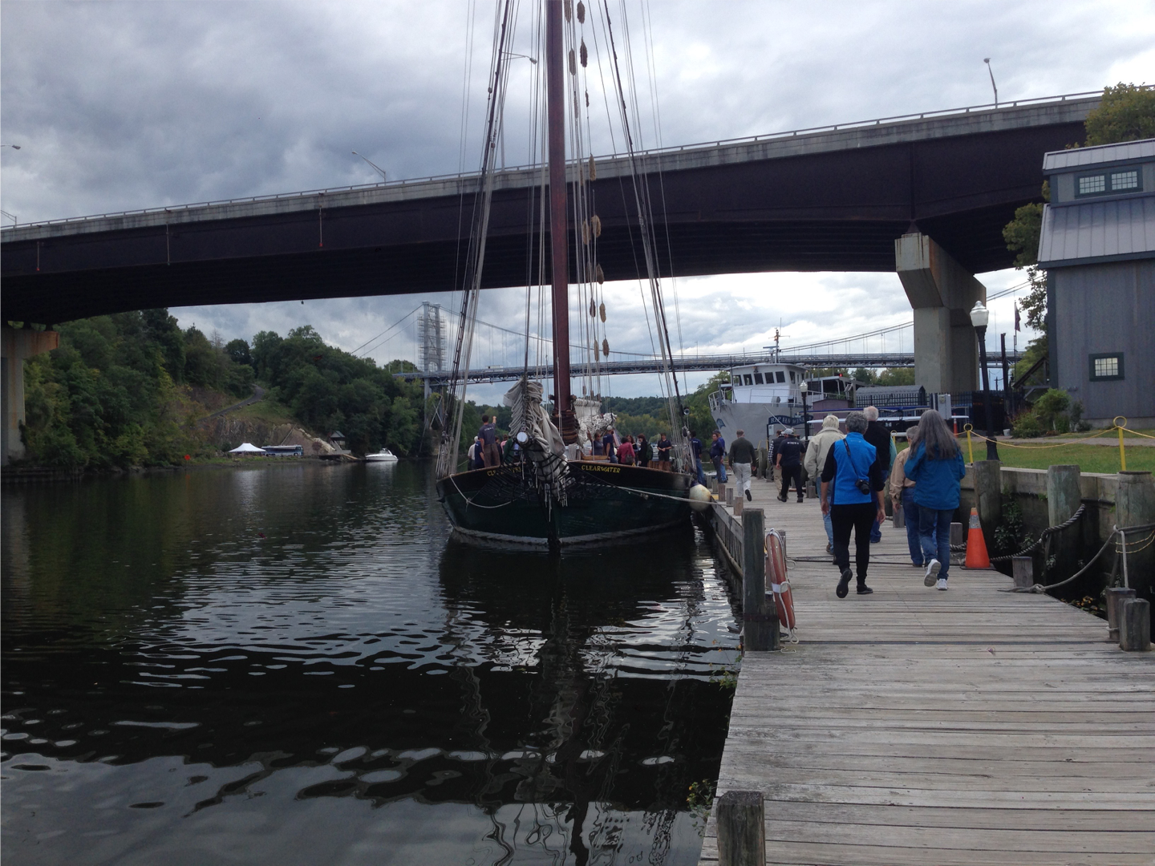
Recreation and Access
  Undeveloped fishing, swimming or boat launch areas
  Access areas in need of repair
  Vulnerable historic or natural features
  Other
Notes:
SACHA

Slide 20
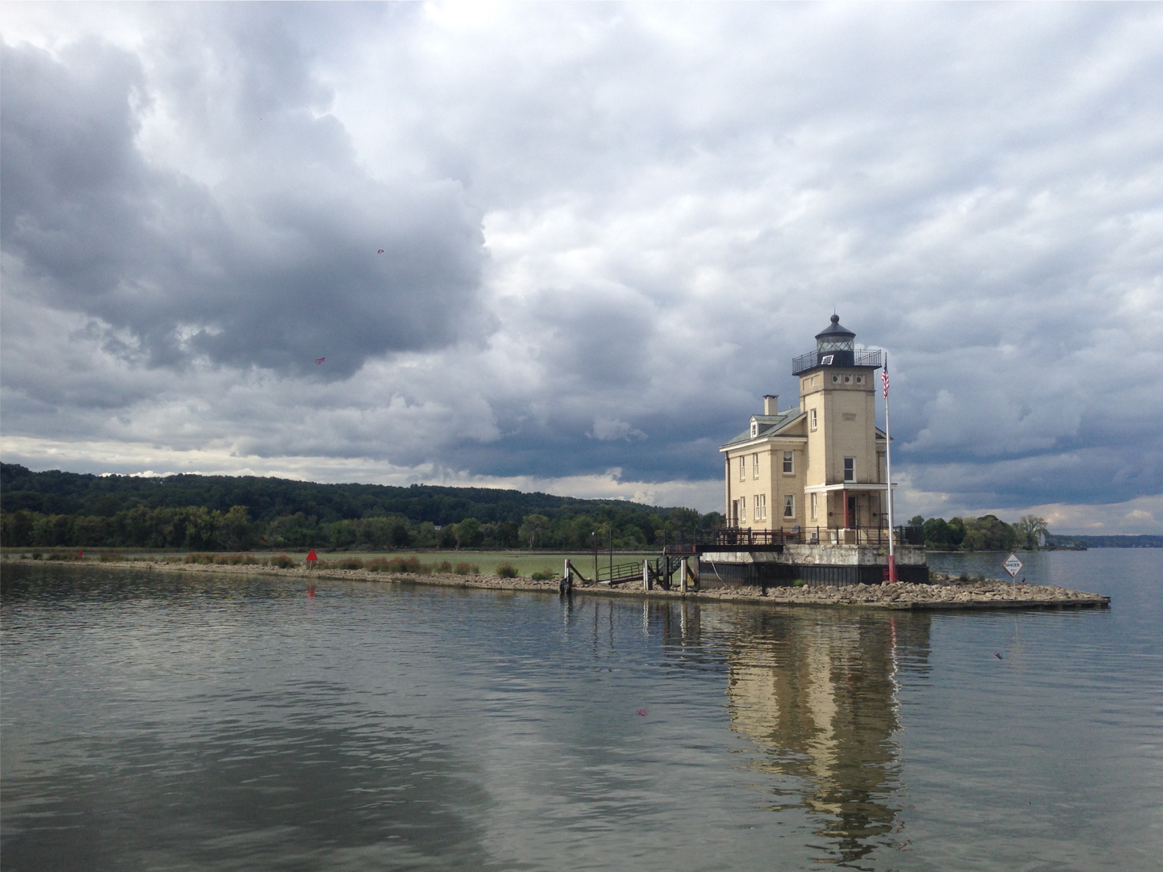
Recreation and Access
  Undeveloped fishing, swimming or boat launch areas
  Access areas in need of repair
  Vulnerable historic or natural features
  Other

Slide 21
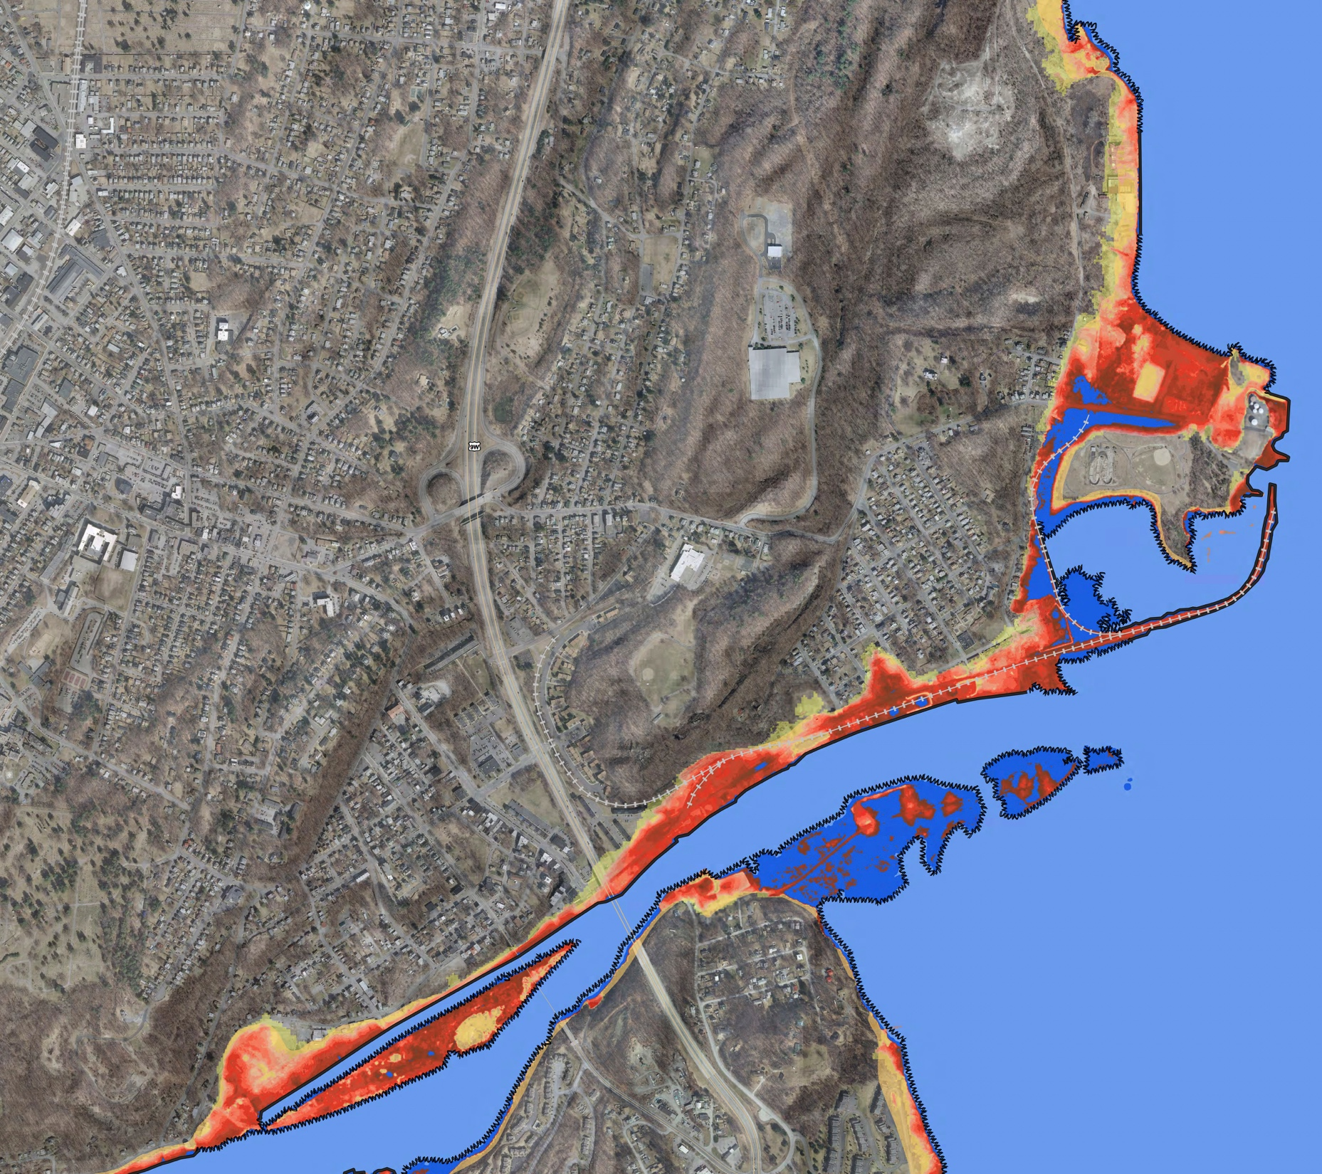
Case Study: City of Kingston
Storm Buffer
Wastewater Infrastructure
Brownfield Remediation
Resilient Waterfront Redevelopment
Recreation & Access
Storm Buffer

Slide 22
Breakout
Groups

Slide 23
Mapping Exercise Prompts
Habitat Restoration and Protection
Shoreline stabilization
Protection of locally important natural resources
Community Infrastructure
Contamination from combined sewer outfalls
Recreation and Access
Undeveloped fishing, swimming or boat launch areas
Open/Green space protection
Brownfields clean-up
Control of Invasive species occurrences
Vulnerable or inadequate wastewater treatment plants and pump stations
Areas or structures prone or vulnerable to storm damage and flooding
Problematic bridges, culverts and dams
Green infrastructure (existing or planned/desired)
Riverfront (re)development areas
Access areas in need of repair
Vulnerable historic or natural features
Other
Brownfields clean-up

Slide 24
Discussion
Reflections: Mapping Exercise
Questions
Next Steps
Final Thoughts
Notes:
ANDY –

