Slide 1
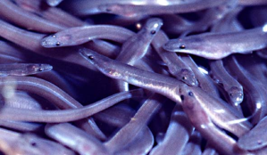
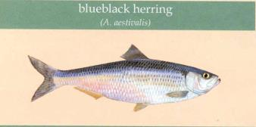
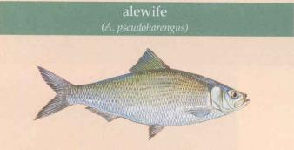
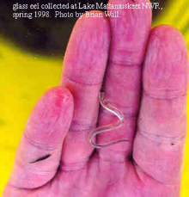
Fish Passage Lessons Learned on the Hudson River
Hudson Valley Restoration Coordination Meeting Columbia Greene CC, Hudson, NY, Oct. 15, 2015 Curtis Orvis, Chief Fish Passage Engineering, USFWS, Northeast Region - Fisheries

Slide 2
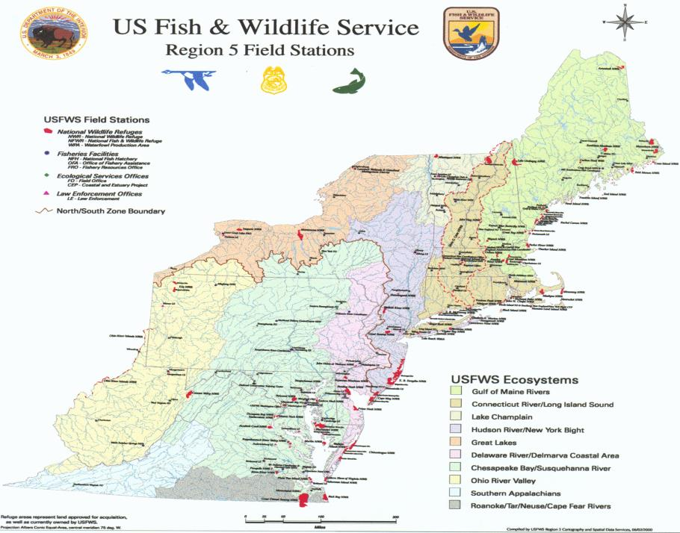
Notes:
New York State includes drainage areas in 7 of the major ecosystems defined by the Service – more than any other state in the northeast region. There are more than 6000 dams segmenting the watersheds.

Slide 3
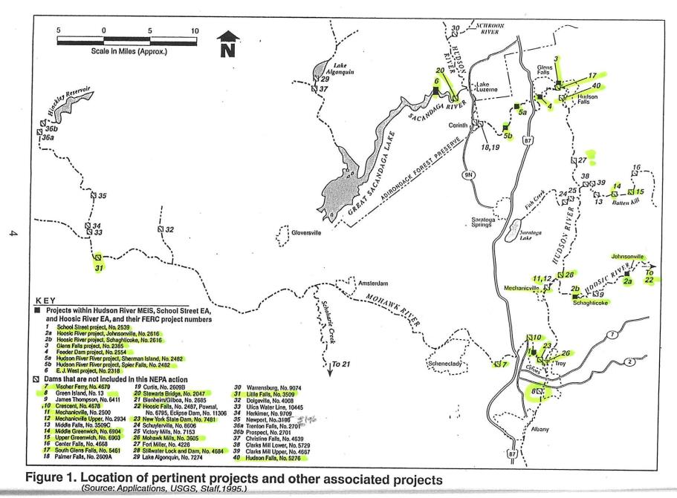
FERC Activities Class of ‘92 to Present 22 Sites

Slide 4
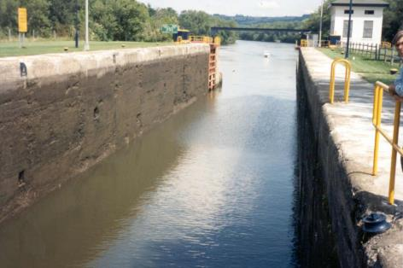
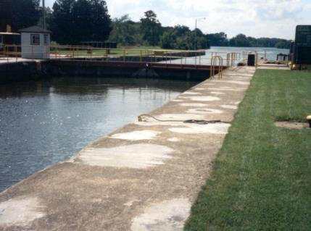
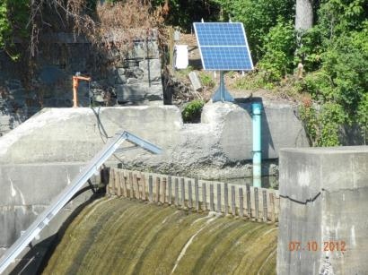
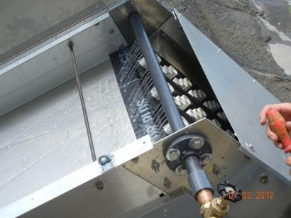
Upstream by Navigation Lock and Eelways
Notes:
Lock on the Mohawk River

Slide 5
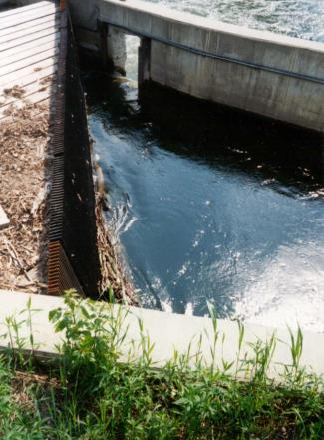
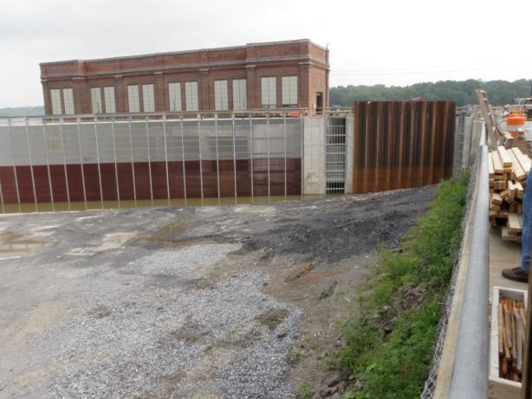
Downstream Protection and Passage using Angled racks

Slide 6
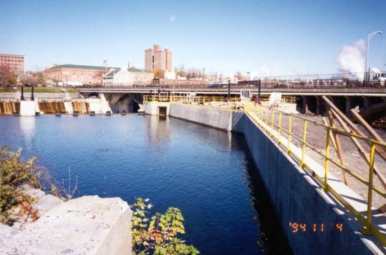
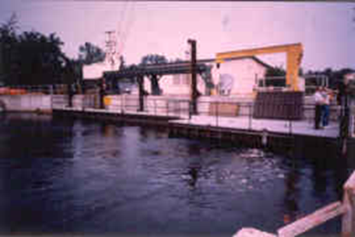
Guide walls and Perpendicular Bar Racks

Slide 7
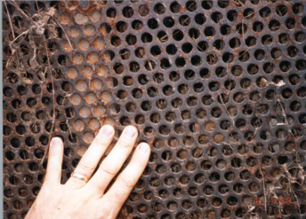
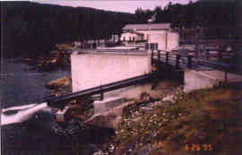
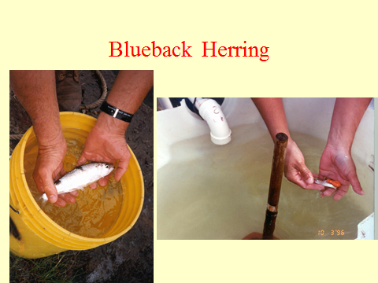
Tested Intake and Pipe

Slide 8
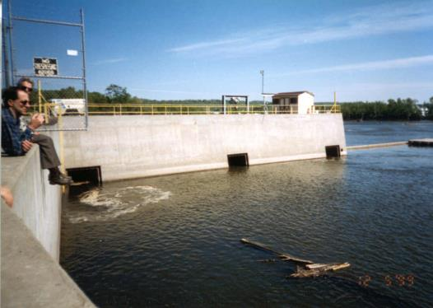
Multiple surface entrances with Hydroacoustics

Slide 9
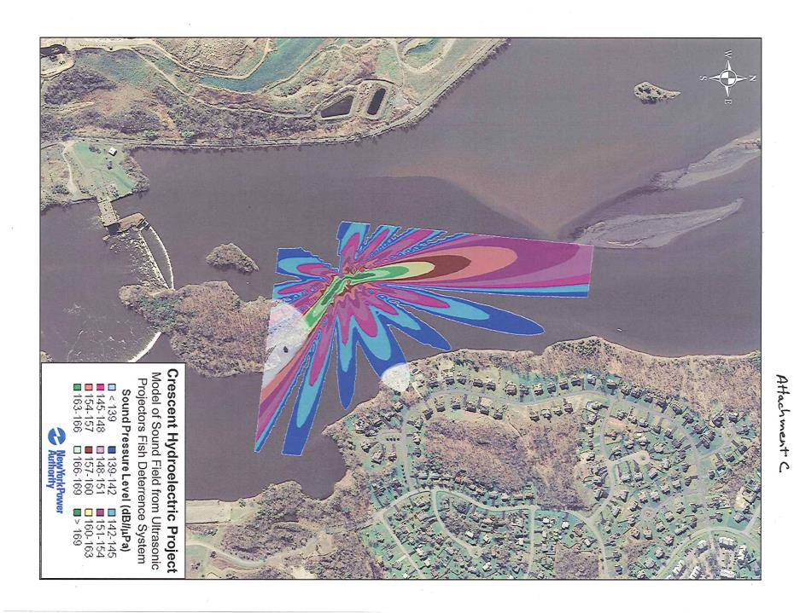
Sound Avoidance

Slide 10
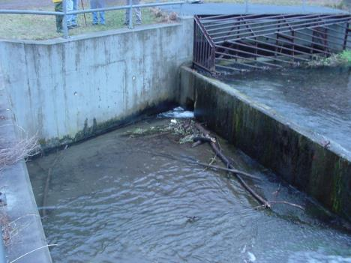
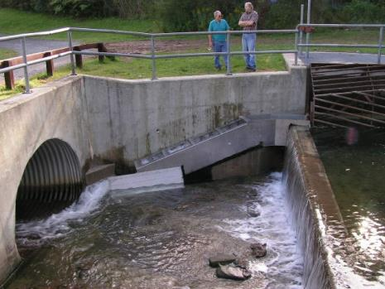
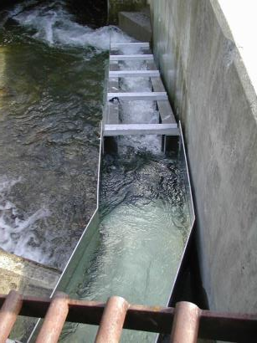
DEC Owned Dam & Fishway

Slide 11
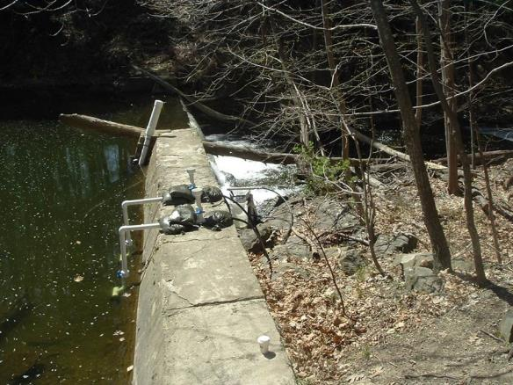
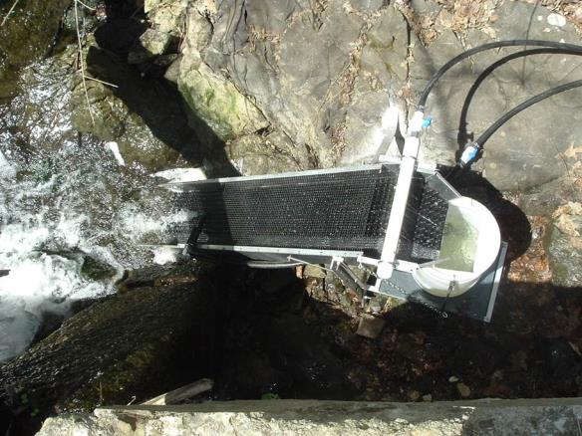
Sawkill Eelway

Slide 12
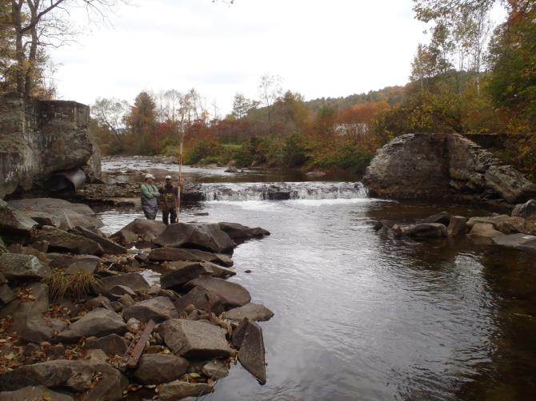
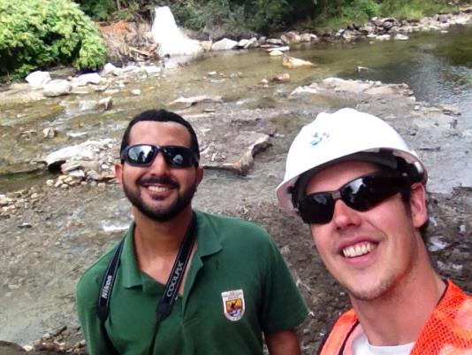
Dam Removal – Groton #9 VT

Slide 13
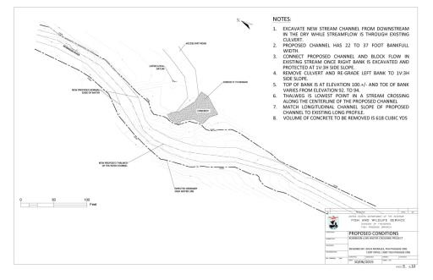
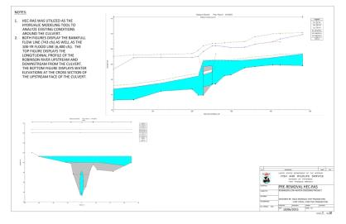
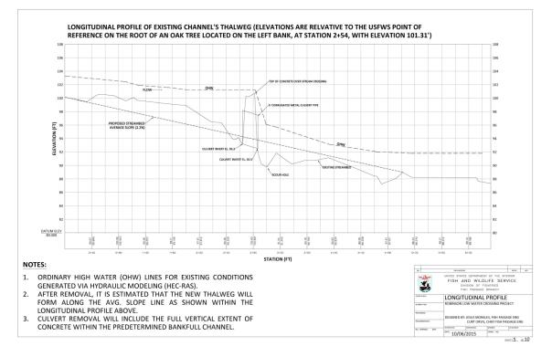

Slide 14
