Slide 1
Tools to Inform
Protection, Restoration, and Resilience
in the Hudson River Estuary
The North Atlantic Landscape Conservation Cooperative (LCC)

Slide 2
Outline
About the North Atlantic LCC
Relevance for work in the Hudson River Estuary
Overview of three conservation tools:
Key components
The products
Applications
How partners are using them

Slide 3
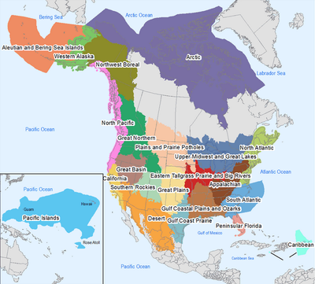
Landscape Conservation Cooperatives (LCCs)
Big picture approach to conservation
22 in international LCC Network
established concurrent to DOI Climate Science Centers
organized based on ecologically connected landscapes, rather than political boundaries
Notes:
LCCs exist because fish, wildlife, and natural processes don’t adhere to political boundaries. Neither should our measures to protect them. If you are here, I don’t need to sell you on that point. Approaching conservation of the Hudson River at the estuary scale makes more sense than through the municipalities that border the river alone.
While biggers scales make ecological sense, they present logistical challenges. The LCC Network was conceived of as a means of addressing conservation challenges are are larger than any one organization,

Slide 4
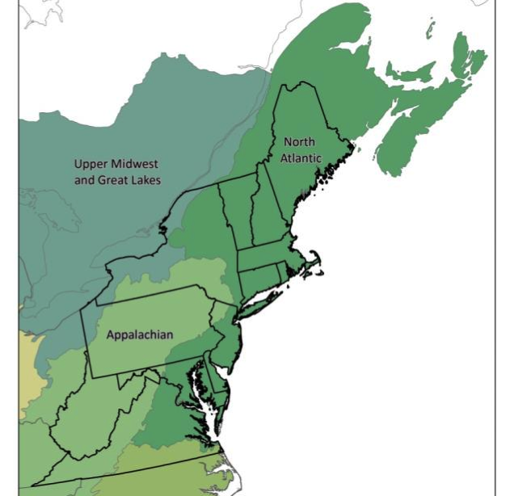
The North Atlantic LCC
Based on partner goals and needs
best available science, scaled to region
coordination among partners working at different scales, with different strengths
scientific and technical support
Notes:
Like the 22 others in the Network, the NALCC brings partners together to identify shared goals, and then provides the scientific and technical support for them to meet them in the context of climate and land-use change.

Slide 5
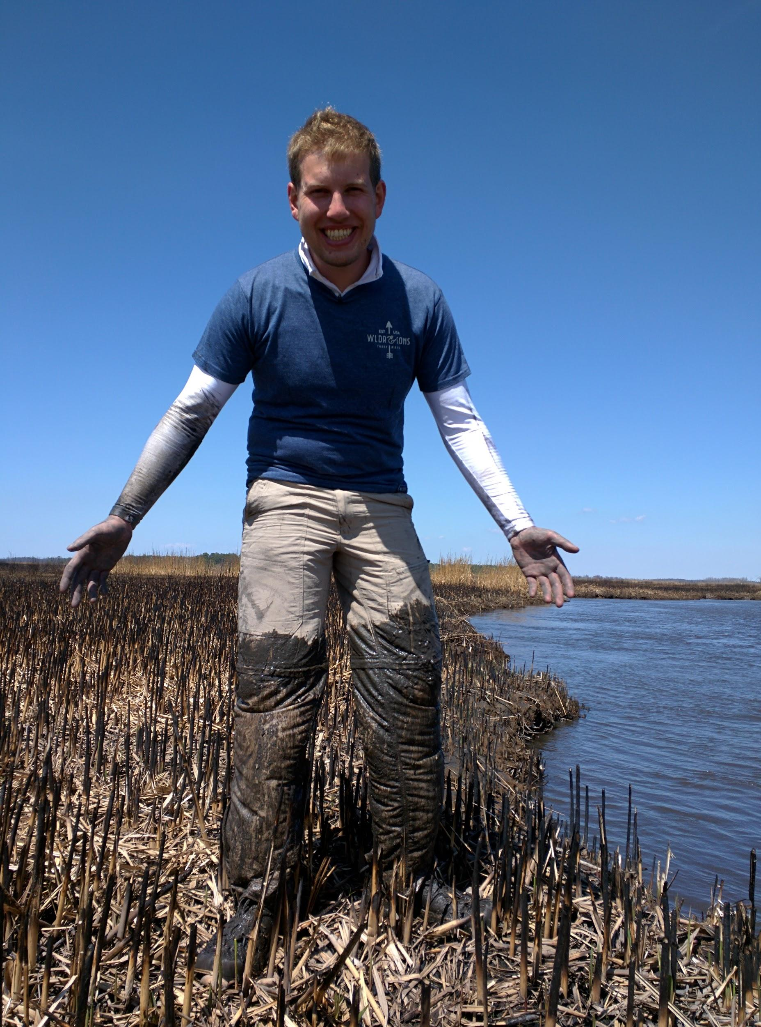
The North Atlantic LCC
With tools designed to inform and support work on the ground
foundational informations
assessments
decision support tools
Notes:
The result is tools that designed to meet partner needs, and inform real work on the ground.

Slide 6
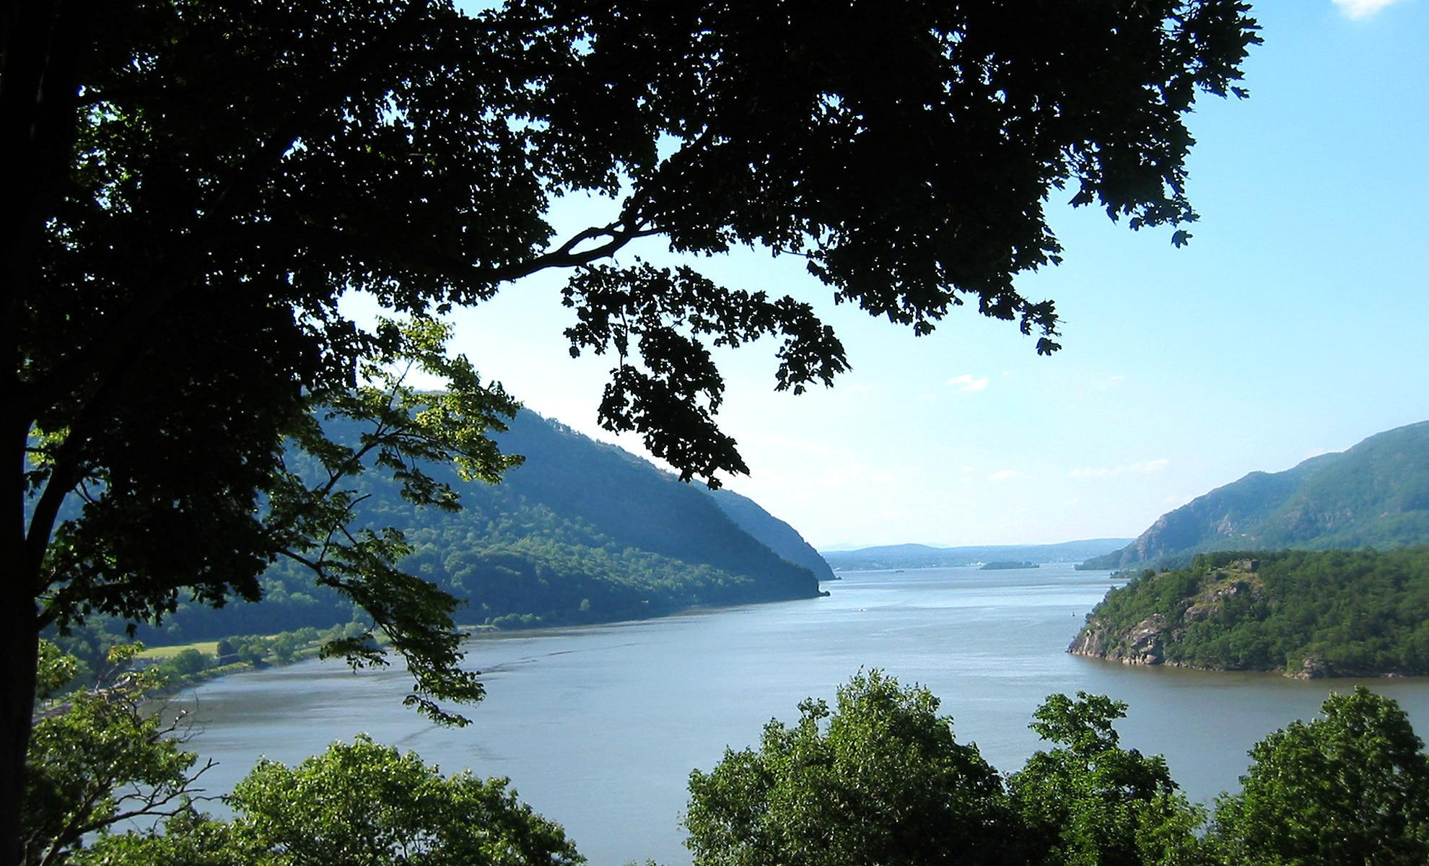
Relevance for work in the Hudson River Estuary
Identifying high-quality habitat
Assessing a site’s ability to sustain ecological functions
Restoring aquatic connectivity, increasing resilience to floods
Notes:
In the Hudson Estuary, that work involves identifying high quality habitat for important species, restoring aquatic connectivity, and increasing community resilience to flooding from intense storms associated with climate change.

Slide 7
The tools:
Identifying high-quality habitat
Assessing a site’s ability to sustain ecological functions
Restoring aquatic connectivity, increasing resilience to floods
Habitat Models for Terrestrial Species

Slide 8
Habitat models for terrestrial species
Project lead:
University of Massachusetts Amherst, Designing Sustainable Landscapes Project

Slide 9
Habitat models for terrestrial species
Key components:
Focus on representative species
Model relationship between species and habitats
Use predictions of land-use and climate-change to assess landscape’s capacity to support species over time
Notes:
It would be challenging to model all species of interest, so we focus on a subset of species that speak for those with similar needs.

Slide 10
Habitat models for terrestrial species
Key components:
Focus on representative species
Model relationship between species and habitats
Use predictions of land-use and climate-change to assess landscape’s capacity to support species over time
Notes:
Based on assessment of three components of local resource availability for breeding

Slide 11
Habitat models for terrestrial species
Key components:
Focus on representative species
Model relationship between species and habitats
Use predictions of land-use and climate-change to assess landscape’s capacity to support species over time
Notes:
Created a climate niche model using climate data and species occurrence data and

Slide 12
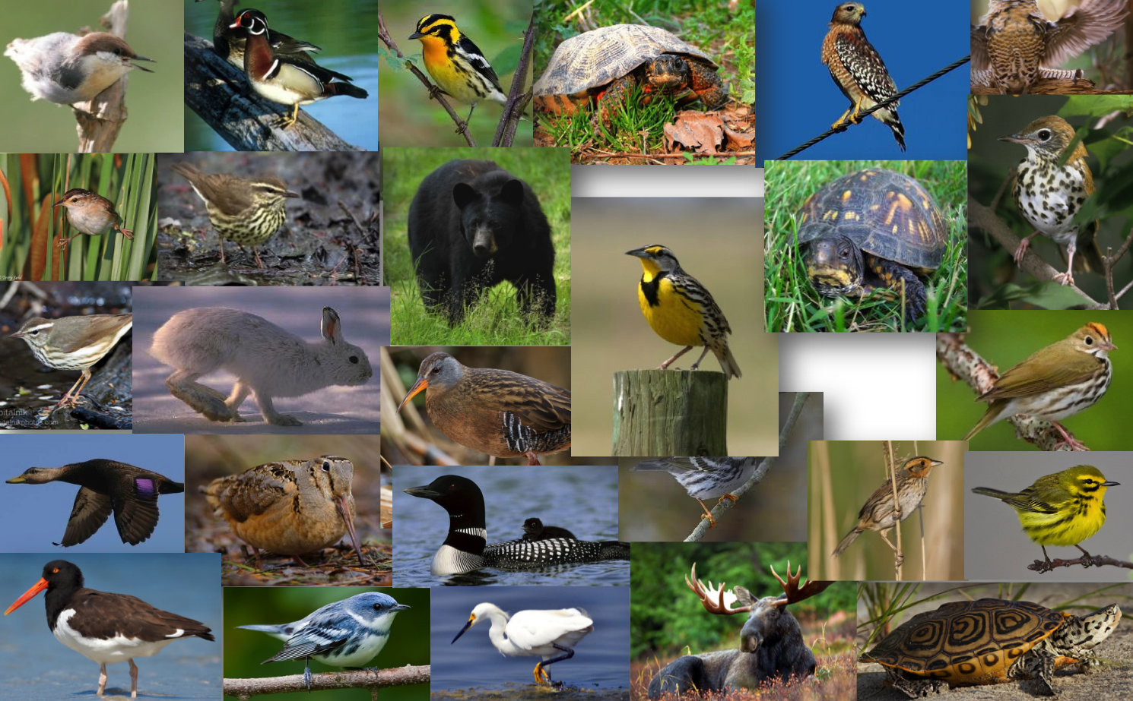
Notes:
30 rep species selected because they typify lifecycles or habitat requirements for a larger group, are sensitive to landscape changes, and because it’s actually possible to monitor them.

Slide 13
Notes:
Species selected because they typify lifecycles or habitat requirements for a larger group, are sensitive to landscape changes, and can be monitored feasibly.

Slide 14
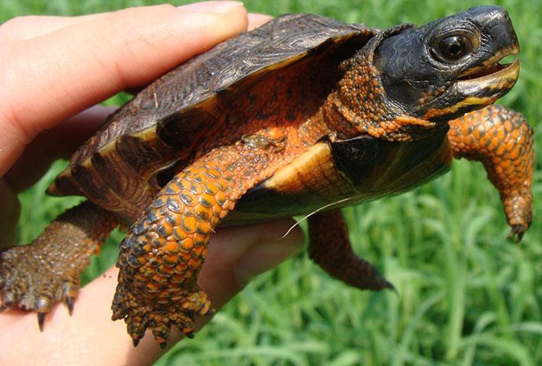
Habitat models for terrestrial species
Wood turtle
Representative species represent:
Habitat type
Requirements/sensitivities
Species with similar needs
Wood turtle

Slide 15
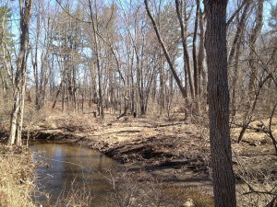
Habitat models for terrestrial species
Wood turtle represents:
Forested streams and adjacent wetlands

Slide 16
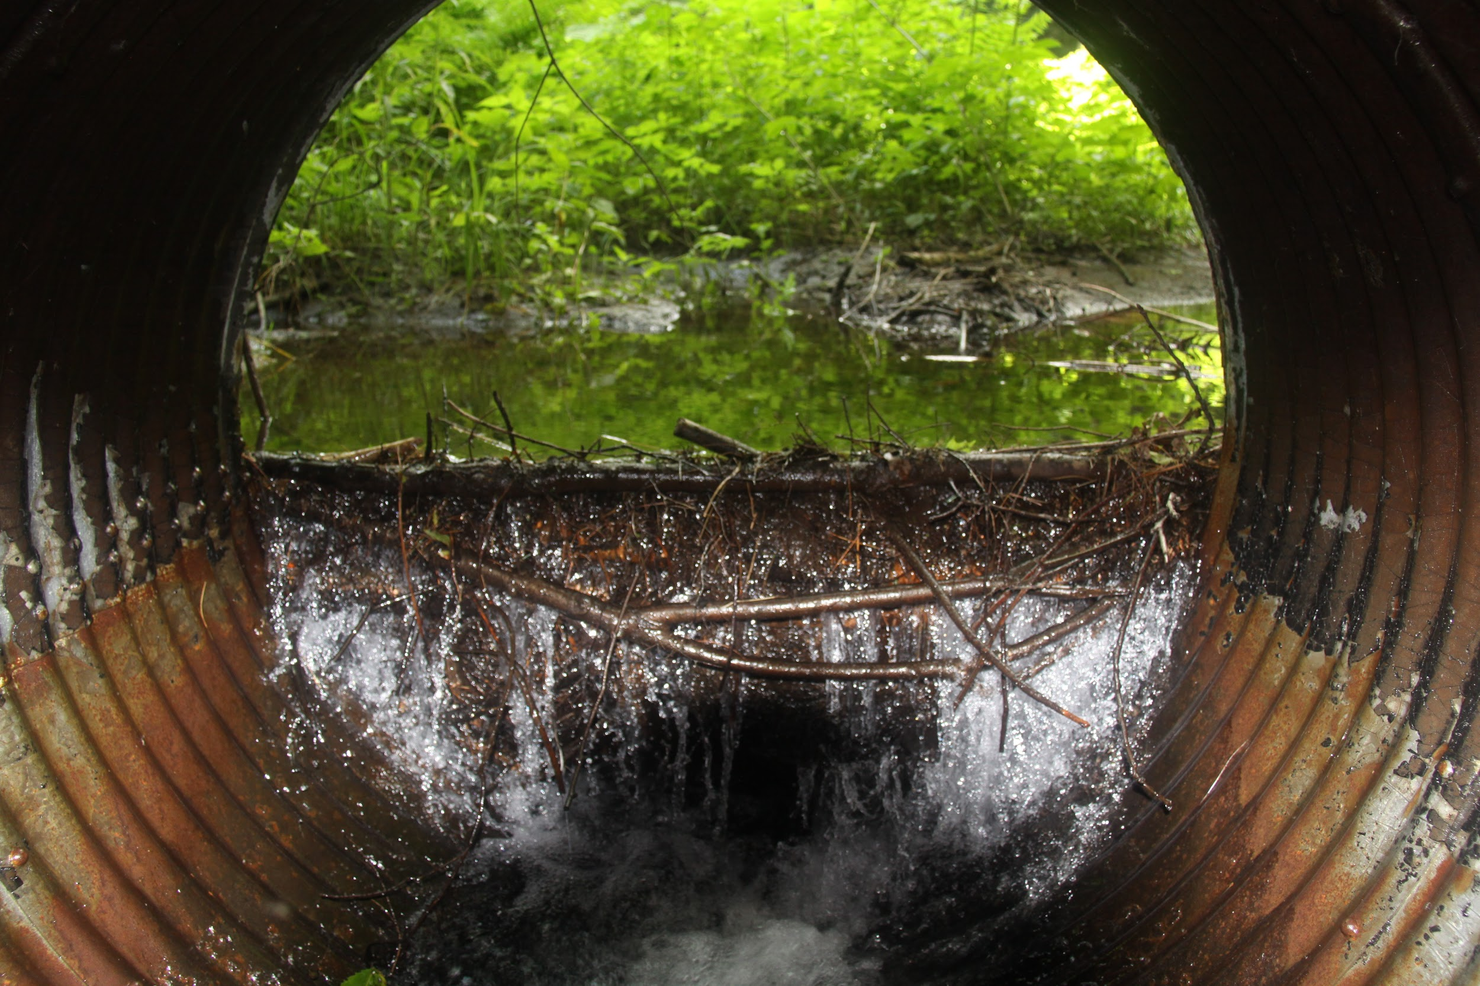
Habitat models for terrestrial species
Wood turtle represents:
Sensitivity to aquatic barriers

Slide 17
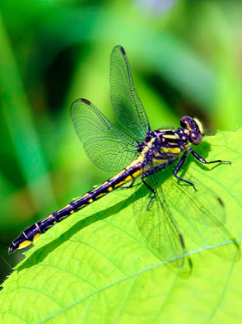
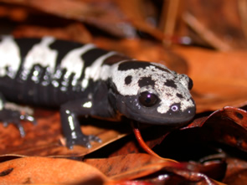
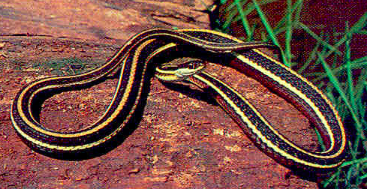
Habitat models for terrestrial species
Wood turtle represents:
Marbled salamander
Rapids clubtail
Eastern ribbonsnake

Slide 18
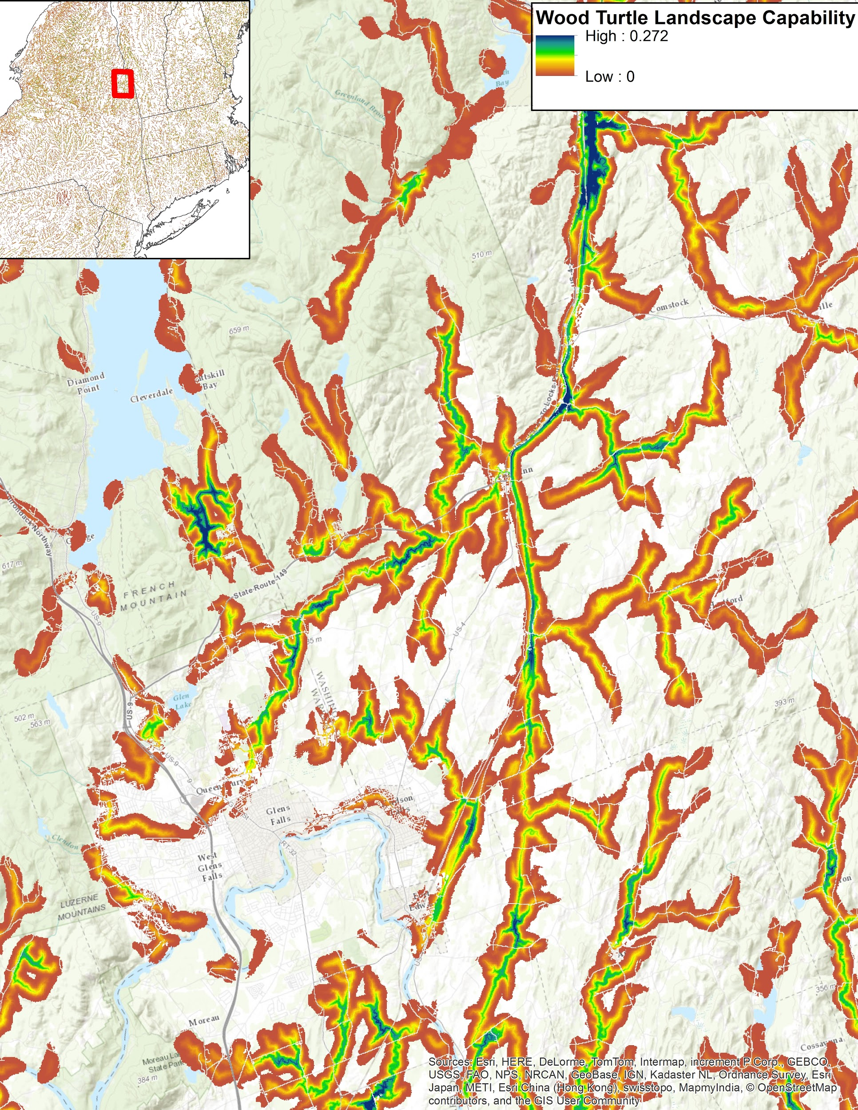
Habitat models for terrestrial species
Products:

Slide 19
Habitat models for terrestrial species
Applications:
Applications:
Identify priority sites for habitat protection
Notes:
Show relatively high value for wood turtle and associated species, and potentially good places to prioritize or at least take a closer look.

Slide 20
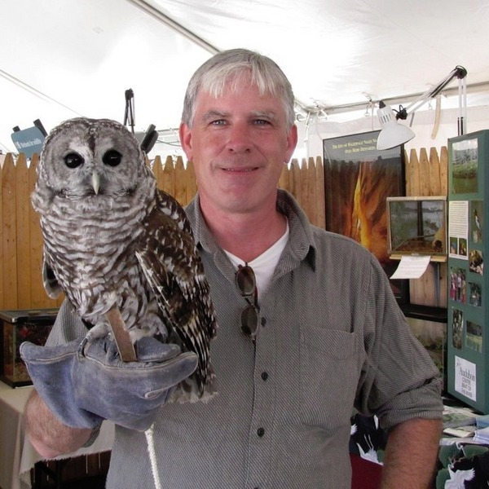
Habitat models for terrestrial species
How partners are using it:
Patrick Comins
Director of Bird Conservation Audubon Connecticut
Predicting ability for focal species for conservation
Notes:
“The representative species models are particularly important, as they give us some predictive ability to determine where our focal species occur. We can’t always get to a site in the breeding season, even if there are species of greatest conservation need present. So the models help get us there.”

Slide 21
Habitat models for terrestrial species
Nota bene!
Rare species models are not publically available
About half of 30 habitat models are available to date

Slide 22
The tools:
Identifying high-quality habitat
Assessing a site’s ability to sustain ecological functions
Restoring aquatic connectivity, increasing resilience to floods
Index of Ecological Integrity

Slide 23
Index of Ecological Integrity
Project lead:
University of Massachusetts Amherst, Designing Sustainable Landscapes Project

Slide 24
Index of Ecological Integrity
Key components:
“Intactness” metrics
Measure freedom from human impairment/anthropogenic stress
Notes:
Habitat loss, watershed habitat loss, road traffic, mowing and plowing, edge effects, watershed road salt, nutrient enrichment, watershed imperviousness, dams, biotic alterations

Slide 25
Index of Ecological Integrity
Key components:
“Intactness” metrics
“Resiliency” metrics
Freedom from human impairment/anthropogenic stressors
Measure capacity to recover from or adapt to disturbances and stress
Notes:
Connectedness, aquatic connectedness, similarity

Slide 26
Index of Ecological Integrity
Key components:
“Intactness” metrics
“Resiliency” metrics
= Ecological Integrity
Freedom from human impairment/anthropogenic stressors
Capacity to recover from or adapt to disturbances and stress

Slide 27
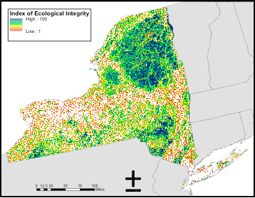
Index of Ecological Integrity
Products:
Notes:
Only compares sites to sites of the same ecological system type. So the blue shading indicates the best across all types. Blue would never only be hardwood conifer forest, because conserving only that type of system wouldn’t get you very far in sustaining long-term ecological integrity.

Slide 28
Index of Ecological Integrity
Products:
Stratified by:
Notes:
Available at regional, state, HUC 6, and Ecoregional scales

Slide 29
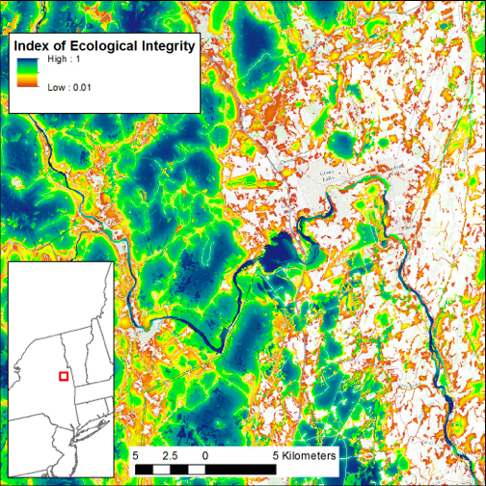
Index of Ecological Integrity
Applications:
Applications:
Identify in tact, resilient landscapes capable of sustaining biodiversity
Notes:
Identify sites capable of supporting ecological processes necessary to sustain biodiversity.

Slide 30
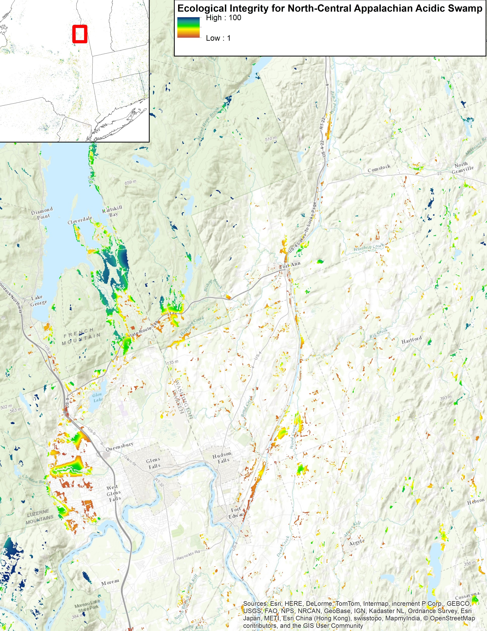
Index of Ecological Integrity
North Central Appalachian Acidic Swamp
Applications:
Applications:
View integrity for a specific system or systems*
Notes:
You cannot parse out the ecological systems looking at IEI alone. That’s where the LCC tech support comes in handy.

Slide 31
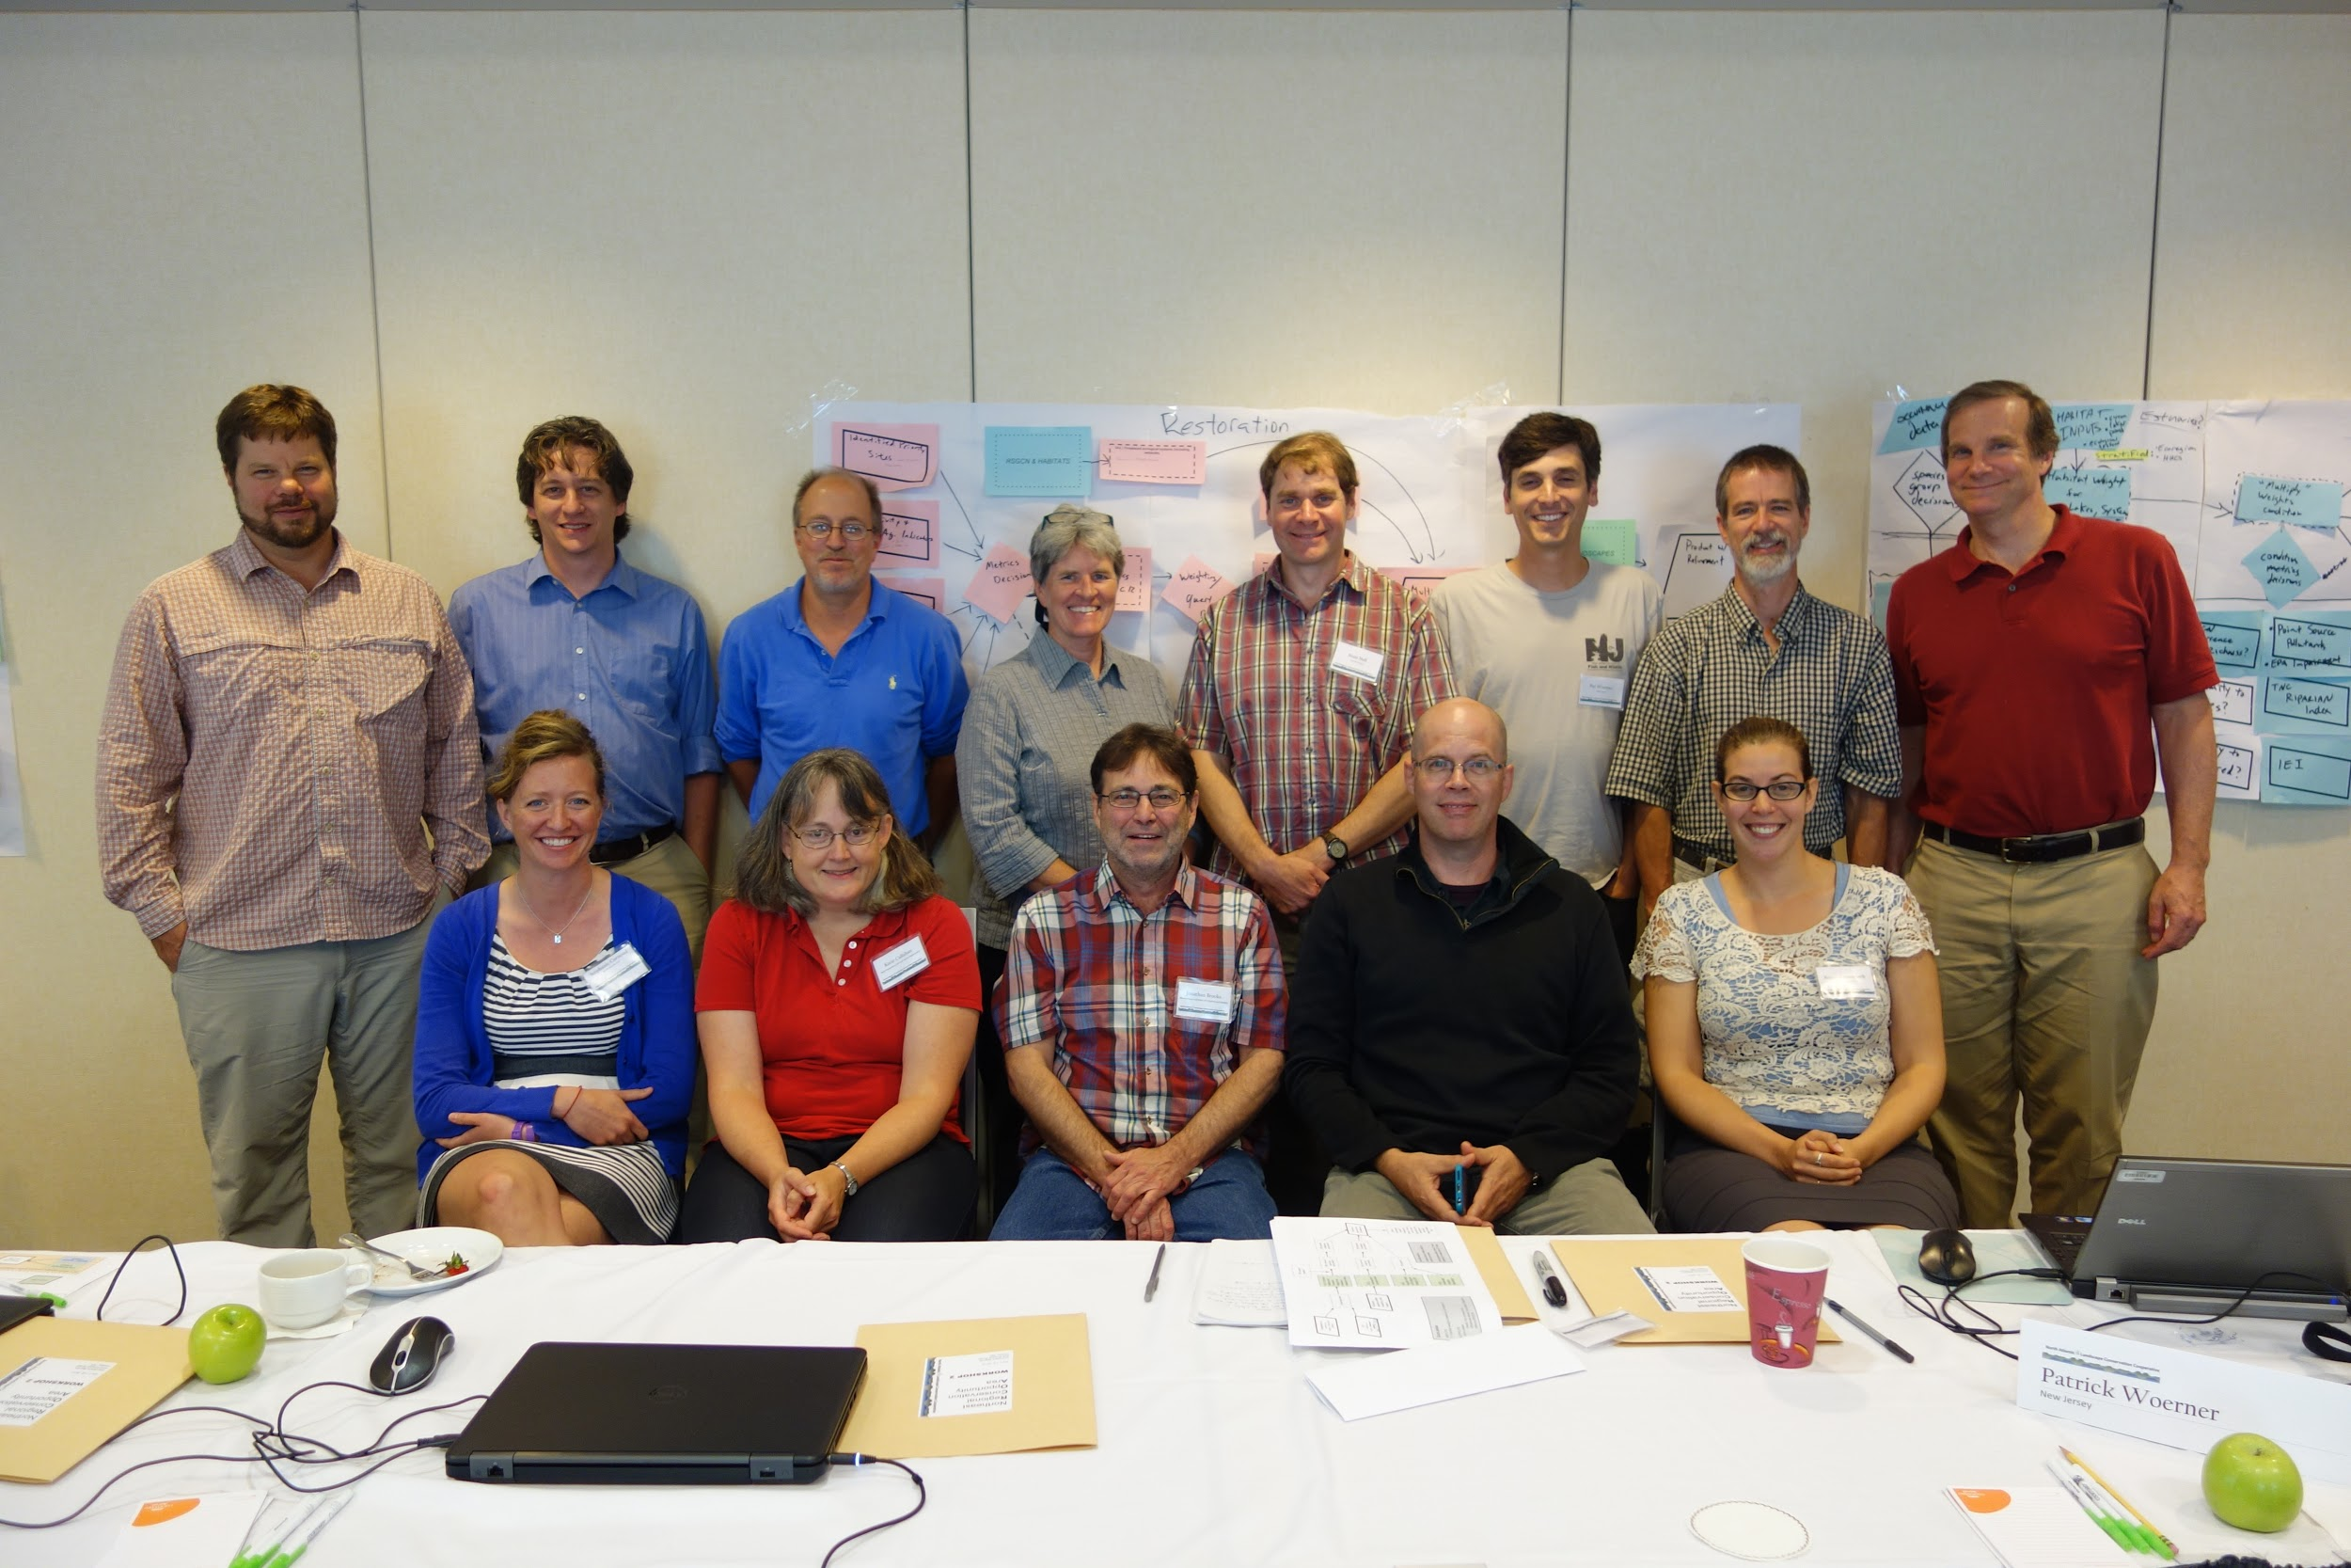
Index of Ecological Integrity
How partners are using it:
Core Team for the Regional Conservation Opportunity Areas project
Identifying a network of intact, connected lands and waters than can sustain RSGCN across the Northeast
Notes:
20 organizations partnering to develop a landscape conservation design for the Connecticut River Watershed LCD, identifying a network of lands and waters that can help sustain important habitats and species into the future. Among the products of this effort are Landscape Capability layers for 15 representative species, including black bear.

Slide 32
The tools:
Identifying high-quality habitat
Assessing a site’s ability to sustain ecological functions
Restoring aquatic connectivity, increasing resilience to floods
North Atlantic Aquatic Connectivity Collaborative

Slide 33
North Atlantic Aquatic Connectivity Collaborative
Project leads:
The Nature Conservancy
The University of Massachusetts Amherst

Slide 34
North Atlantic Aquatic Connectivity Collaborative
Key components:
Consistent regional protocols
Field training for states, towns, and NGOs
Shared online database
Prioritization of road-stream crossings for surveys
Pilot project on vulnerability of road-stream crossings to floods

Slide 35
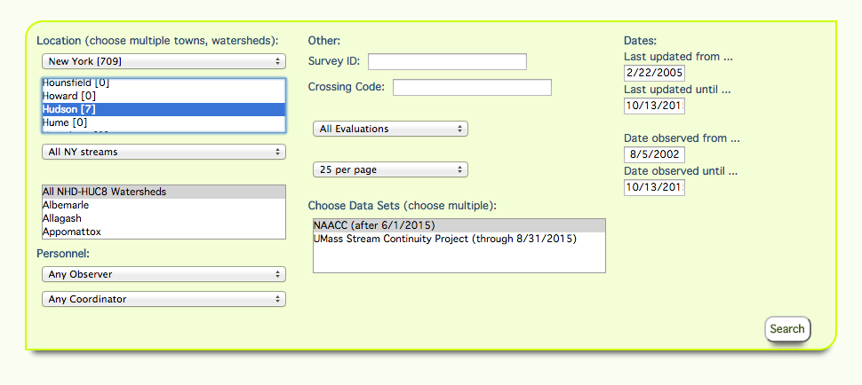
North Atlantic Aquatic Connectivity Collaborative
Products: Online database
Notes:
Crossing data, structure data, and photos

Slide 36
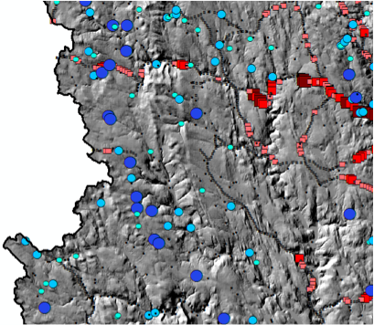
North Atlantic Aquatic Connectivity Collaborative
Products: Prioritization tool
Culverts
High impact
Medium impact
Low impact
Very low impact
Terrestrial road crossings
High impact
Medium impact
Low impact
Very low impact

Slide 37
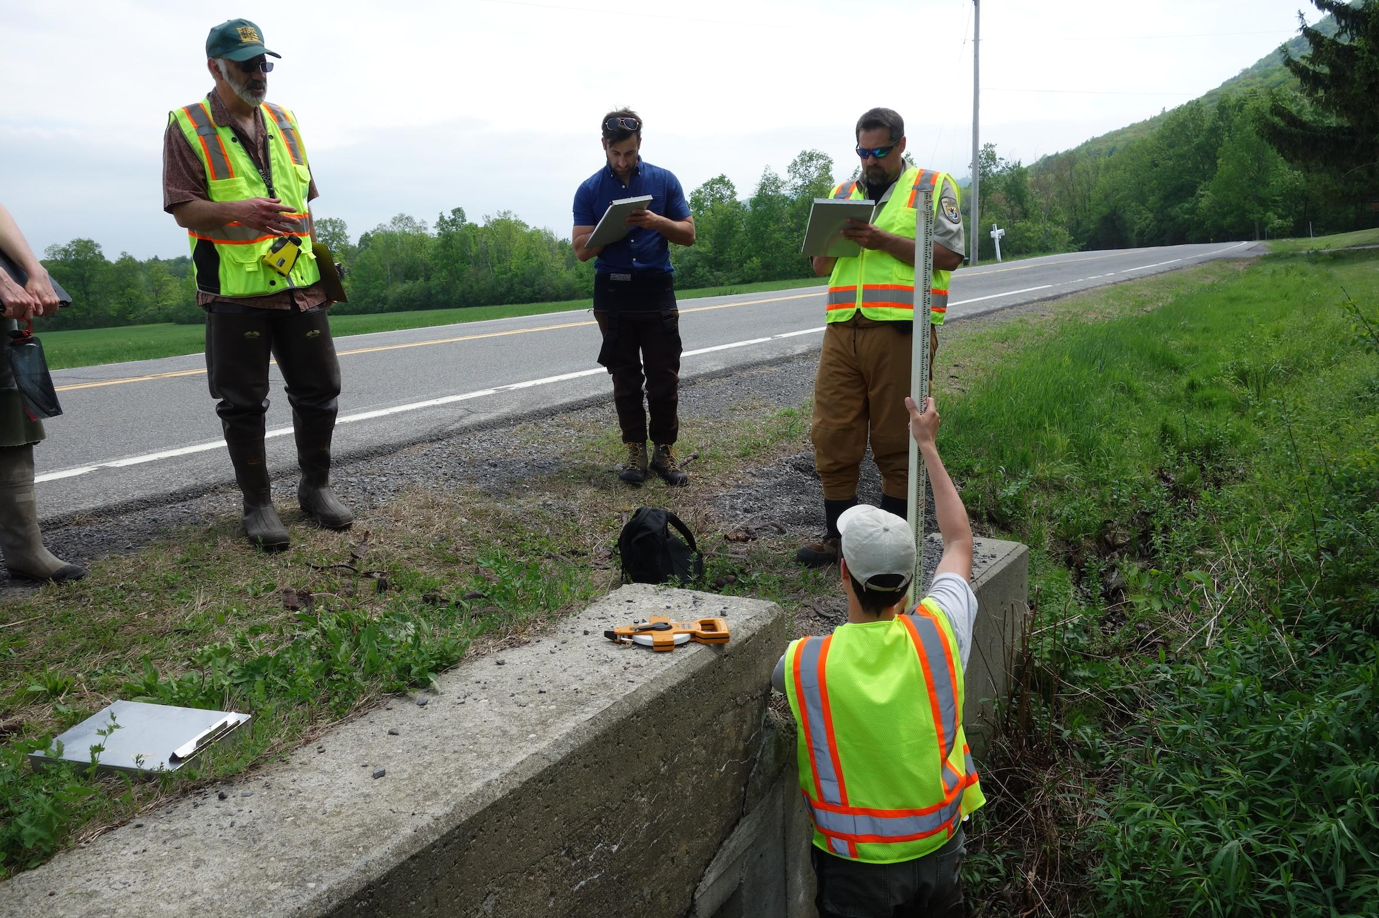
North Atlantic Aquatic Connectivity Collaborative
Products:
Field trainings

Slide 38
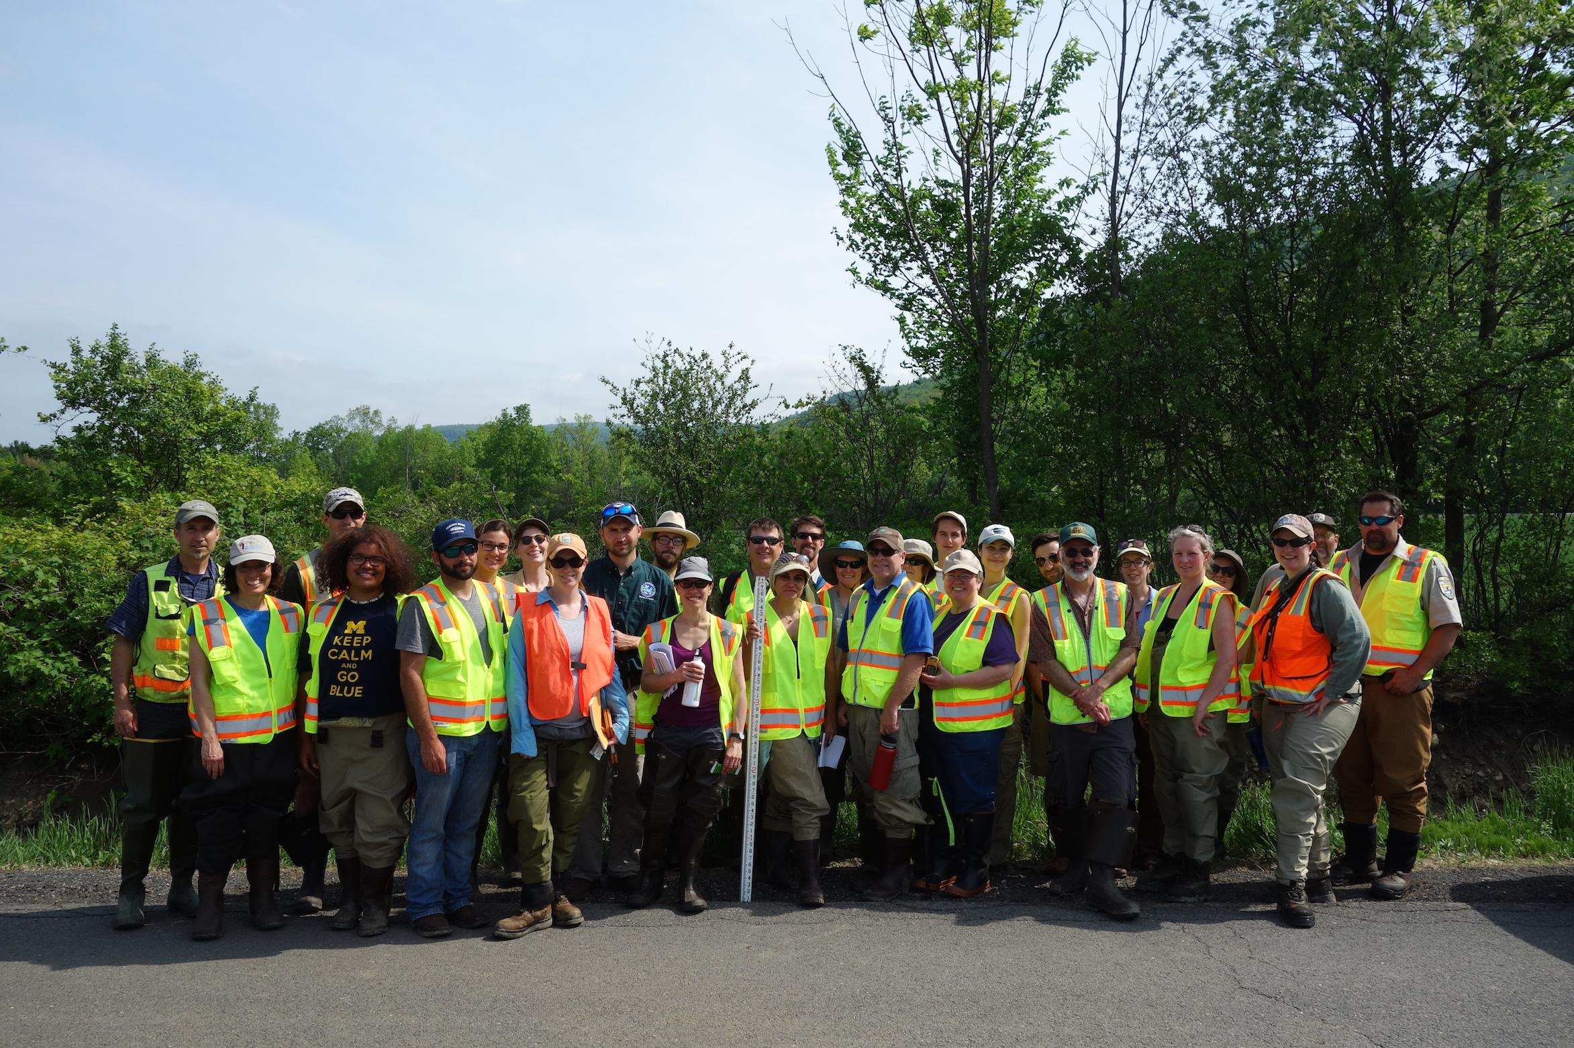
North Atlantic Aquatic Connectivity Collaborative
Products:
Collaboration
Notes:
Strength in numbers for the enormous job of assessing thousands of road-stream crossings across the region

Slide 39
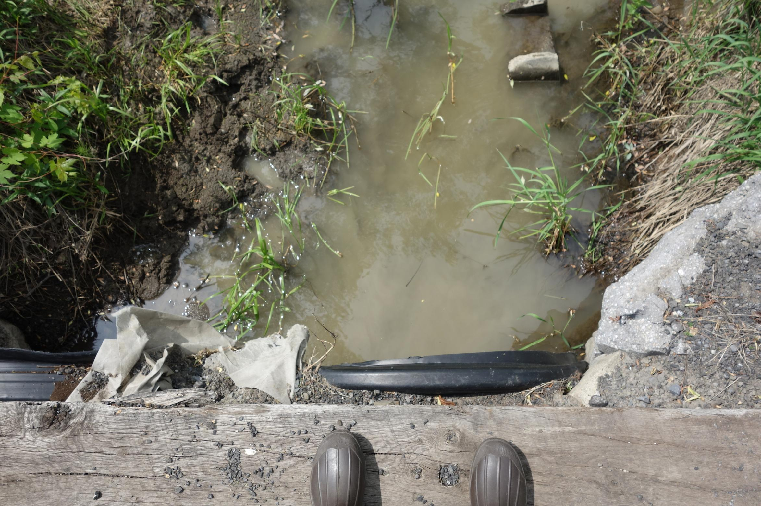
North Atlantic Aquatic Connectivity Collaborative
Applications:
Direct future surveys
Prioritize funding
Prioritize mitigation strategies
Improve connectivity

Slide 40
North Atlantic Aquatic Connectivity Collaborative
How partners are using it:
Betty Ketchum, Environmental Specialist, New York State Department of Transportation, InterACT Program
Prioritizing culvert replacements to maximize limited funding available
Notes:
“I’m part of a group called interact that is an interagency group – DOT, FW, DEC – and the purpose is to try to get better crossing for culverts. Because we have limited funding, and replacements often cost about four times as much as a repair, I’m really interested in finding out how to prioritize the ones that are most important to replace.”

Slide 41
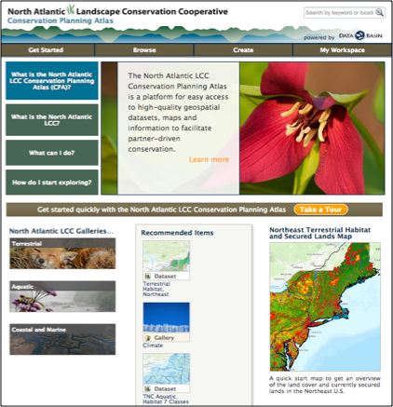
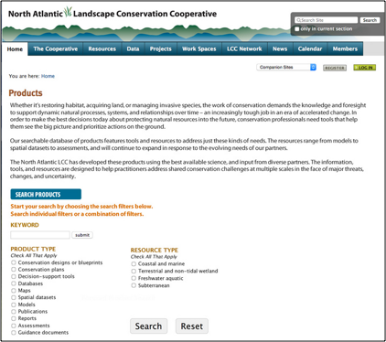
Accessing the tools
North Atlantic LCC Conservation Planning Atlas
North Atlantic LCC Products Page
Notes:
Accessing the tools

Slide 42
More information
Andrew Milliken, North Atlantic LCC Coordinator
andrew_milliken@fws.gov
Scott Schwenk, Science Coordinator
william_schwenk@fws.gov
Megan Tyrell, Coastal Resilience and Aquatic Connectivity Coordinator
megan_tyrell@fws.gov
Renee Farnsworth, Spatial Data Manager
renee_farnsworth@fws.gov
Notes:
Technical experts

Slide 43
More information
www.northatlanticlcc.org
Notes:
Our homebase

